Slide 1
ICS Presentation Project
Minghao Chi, Xincheng Huang, Zhanghao Chen
2016/12/13

Slide 2
Reliable Messaging

Slide 3
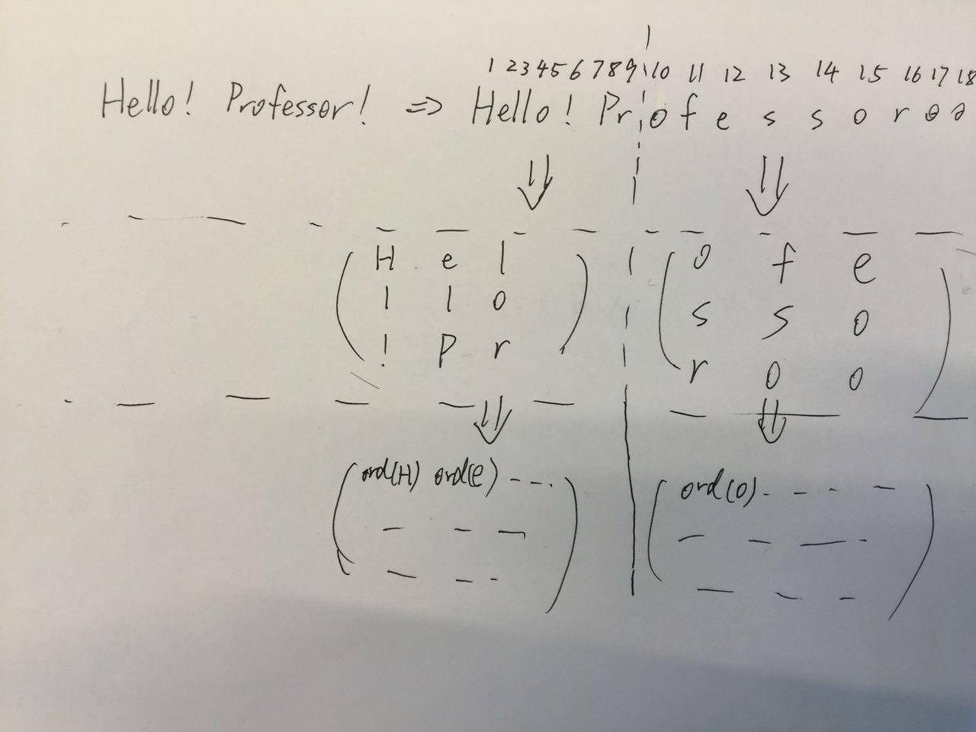
Reliable Messaging-Principals

Slide 4
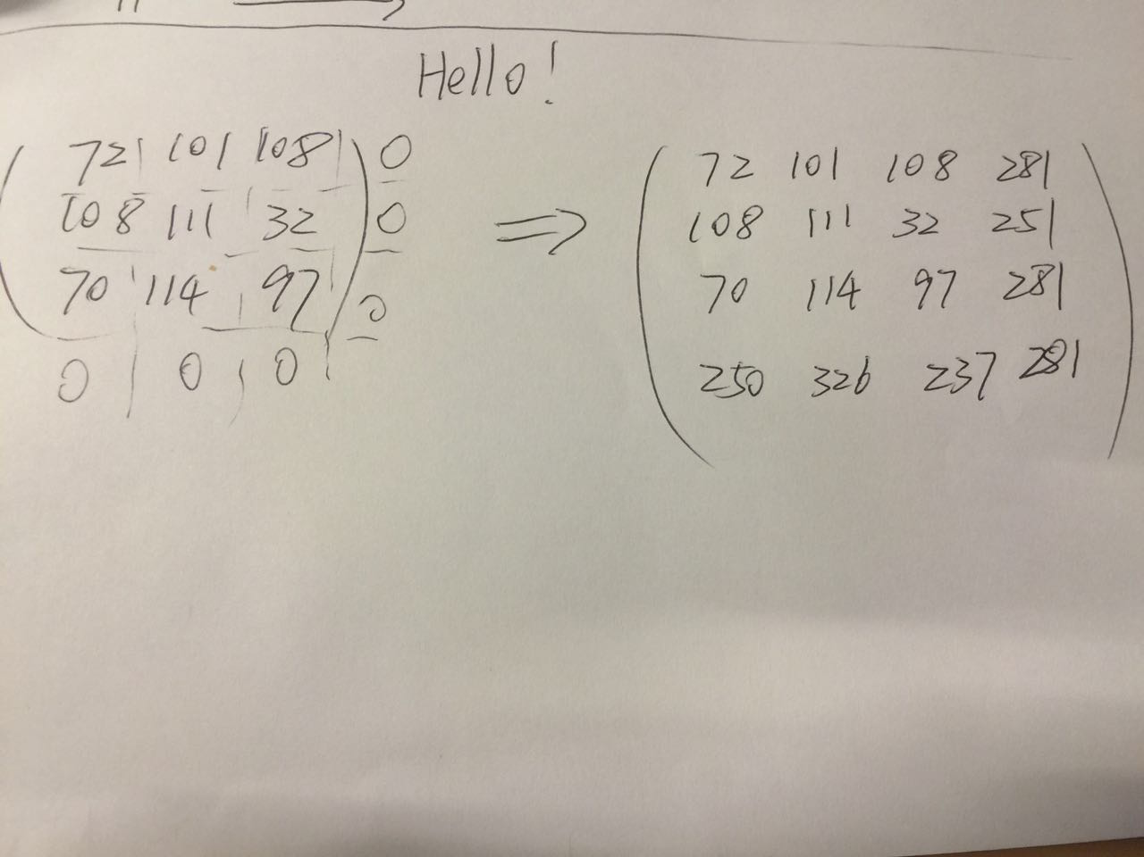
Reliable Messaging-Principals

Slide 5
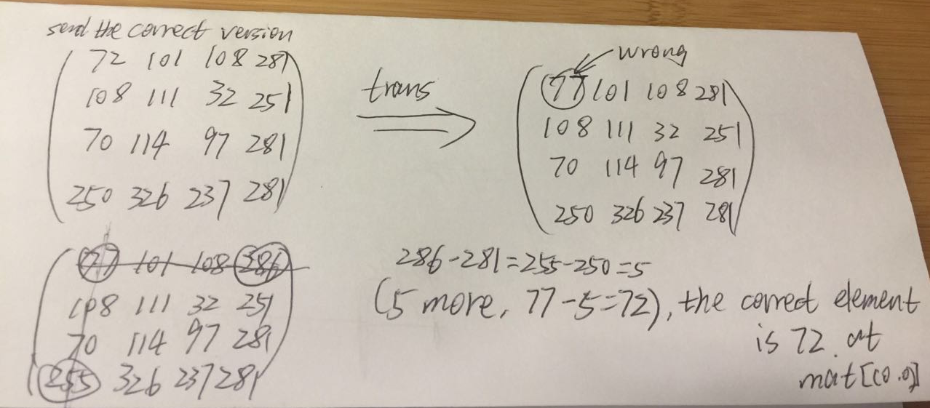
Reliable Messaging-Principals

Slide 6
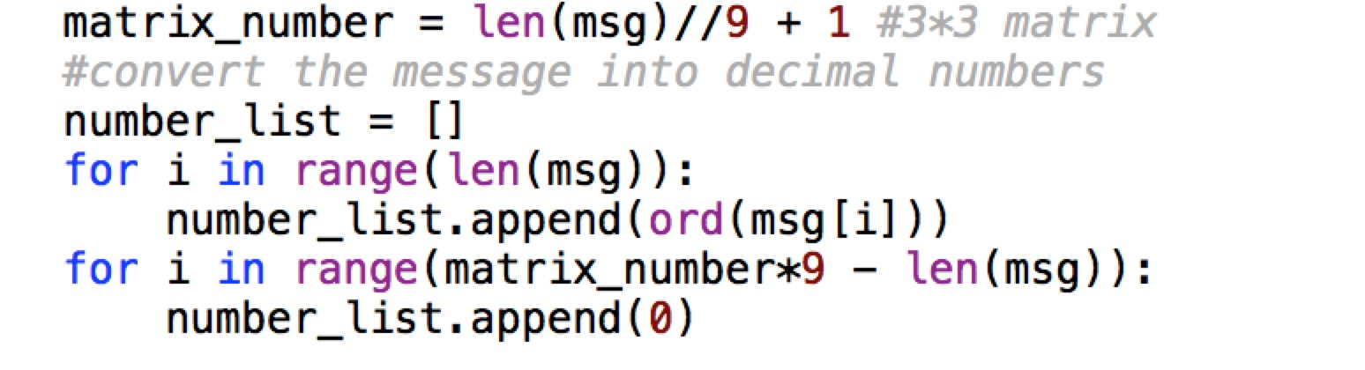
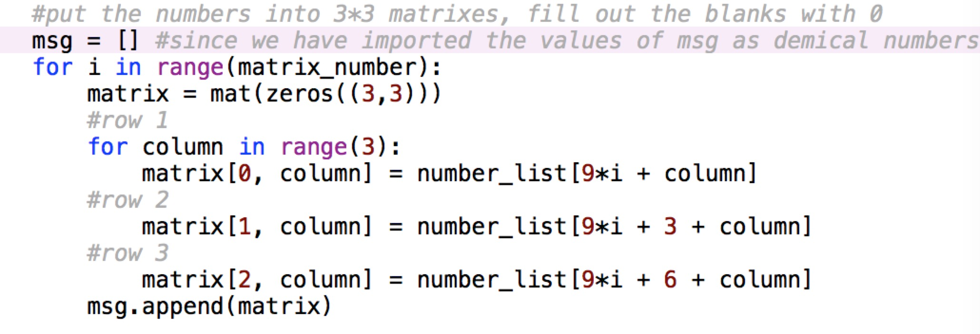
Reliable Messaging-Send
Convert the entire message into separate strings, and then decimal numbers.
Put the numbers into the matrix

Slide 7
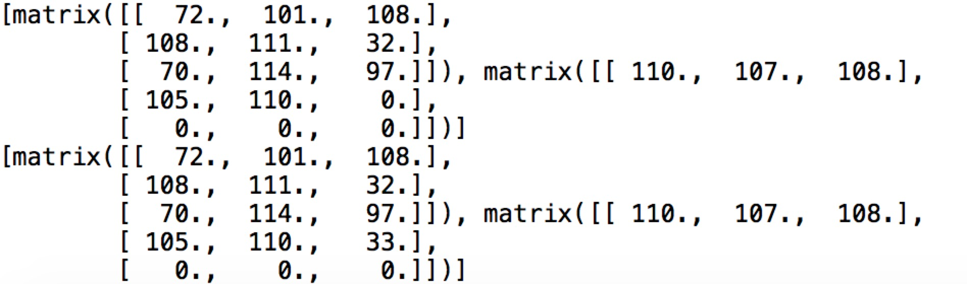
Reliable Messaging-Send
Print(msg), we will have a list in which the elements are matrixes

Slide 8
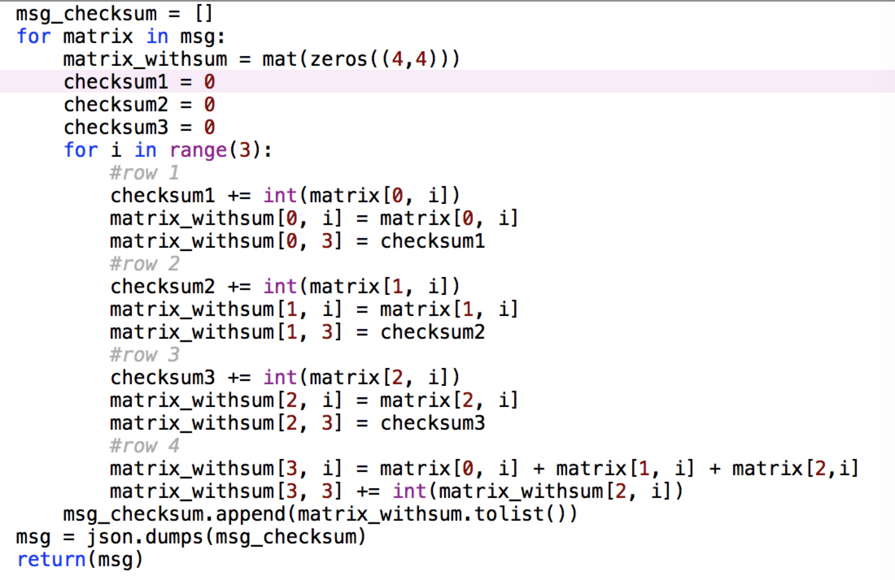
Reliable Messaging-Send
Make the checksums and from a larger matrix
Serialization to send the message

Slide 9
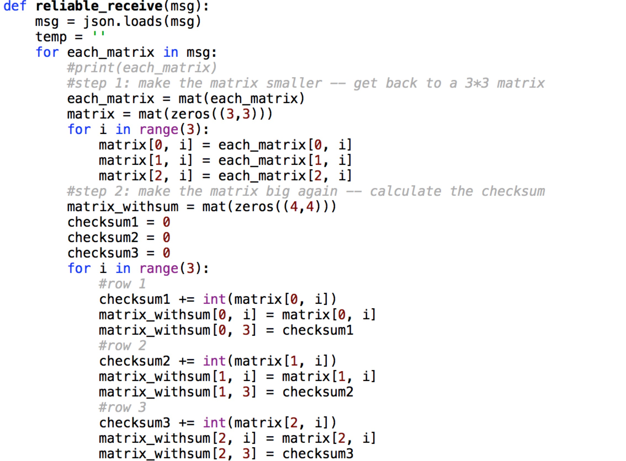
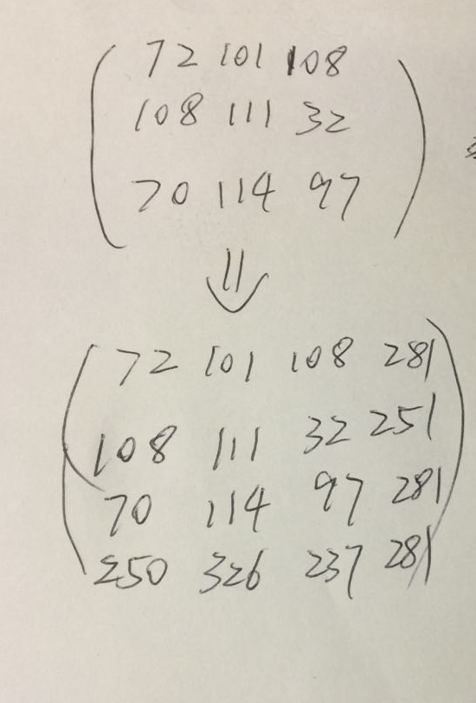
Reliable Messaging-Receive
Implement the checksum again

Slide 10
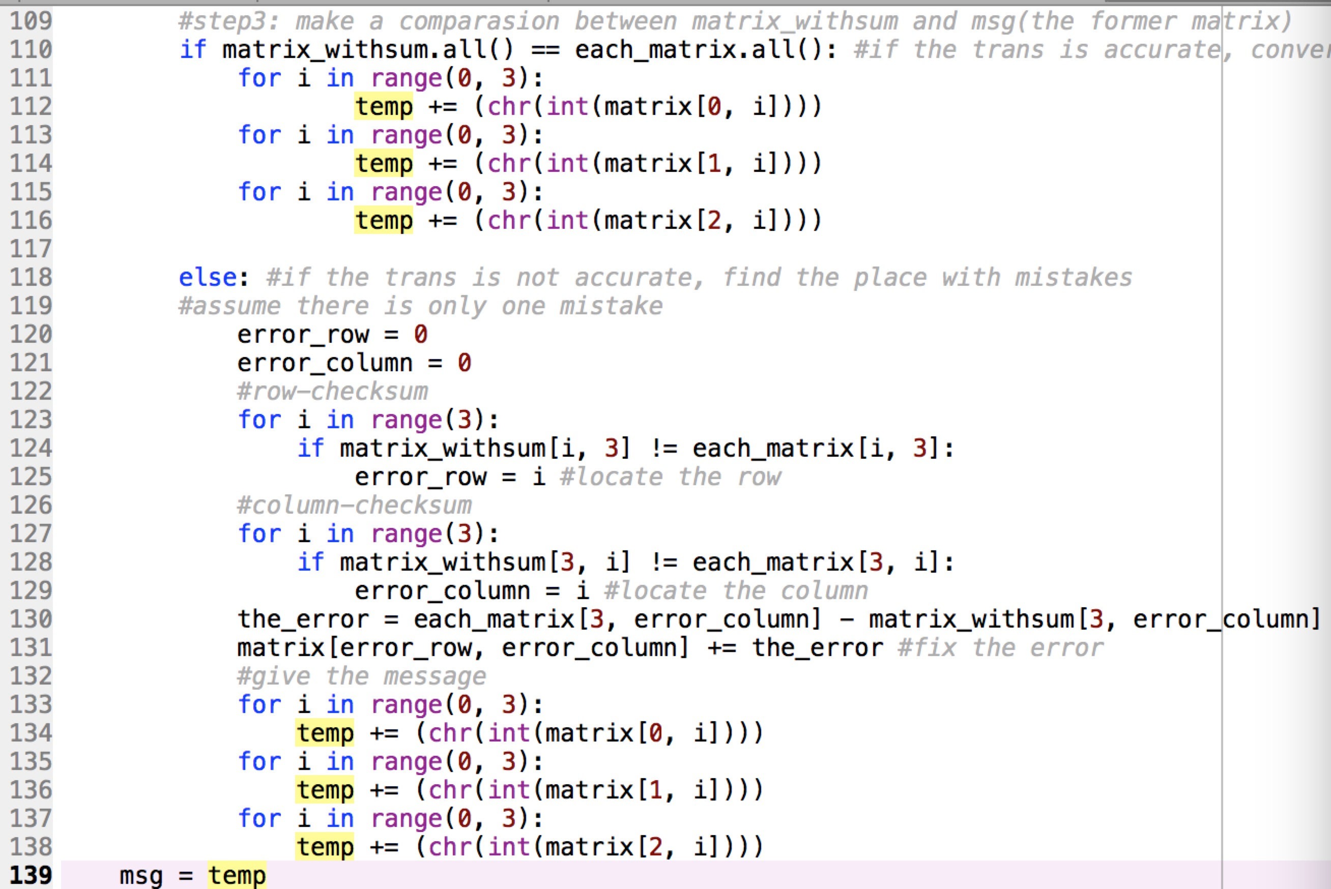
Reliable Messaging-Receive
Write an ‘if’ to decide whether the trans is accurate
If not, fix the error
(assume that there is only one error)
Translate the matrix back to the string

Slide 11
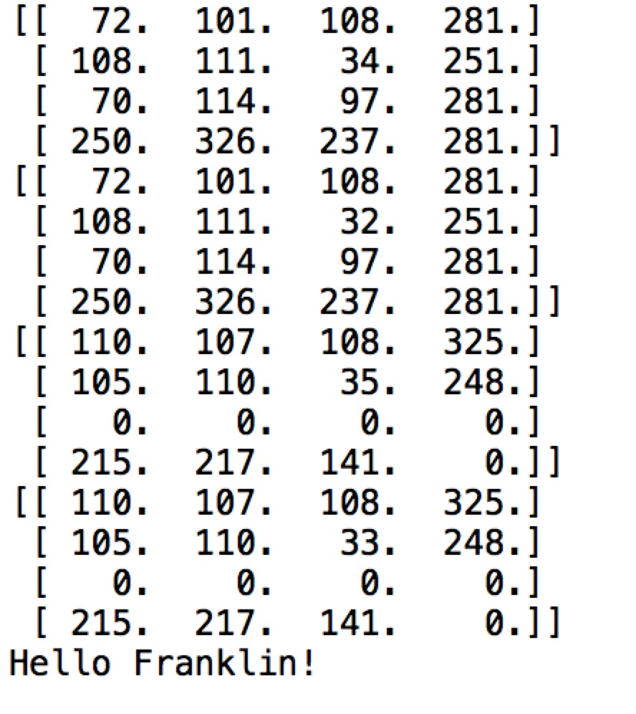
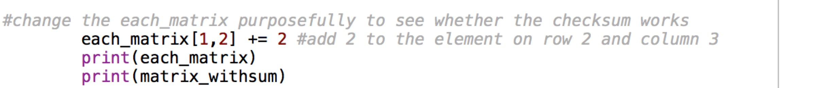
Test method: interrupter
Interrupter will mess up one element of the matrix
At the end of the code, call the functions(send and receive)

Slide 12
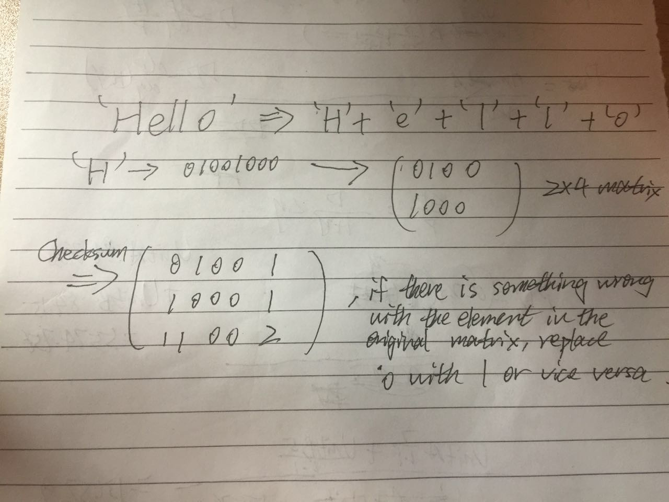
Attempt 2: 2*4 matrix
The checksum part and the comparison part are the same.
The difference is the elements in the matrix is 1 or 0
The size of the matrix is 2*4

Slide 13
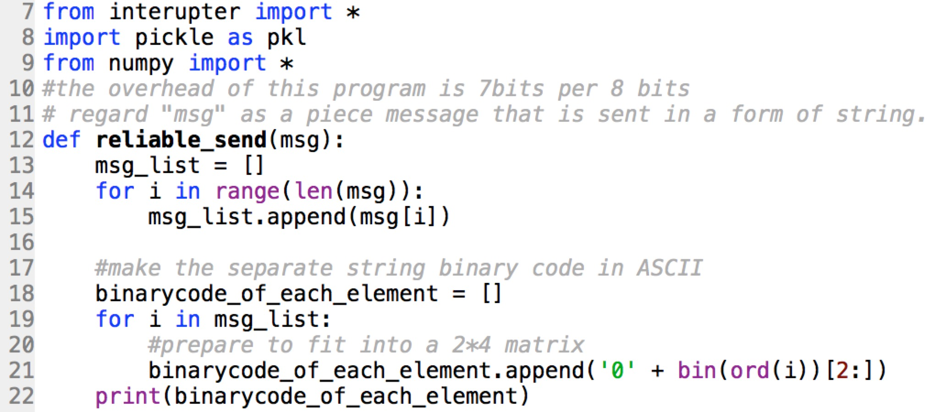
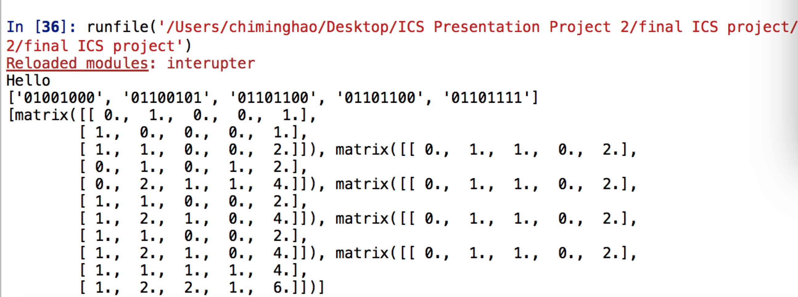
Attempt 2: a 2*4 matrix
In the list “binary_code_of_each_element”, there are binary codes of separate strings of message
The matrix with checksum

Slide 14
Comments on 2*4 Matrix
This method will test the message bit by bit.
Weakness: Too much redundancy. Almost double the former data (from 8 digits to 15 digits)
Unstable when running long messages
Only detect one error in the ASCII code of a single string, less effective in terms of error correction.

Slide 15
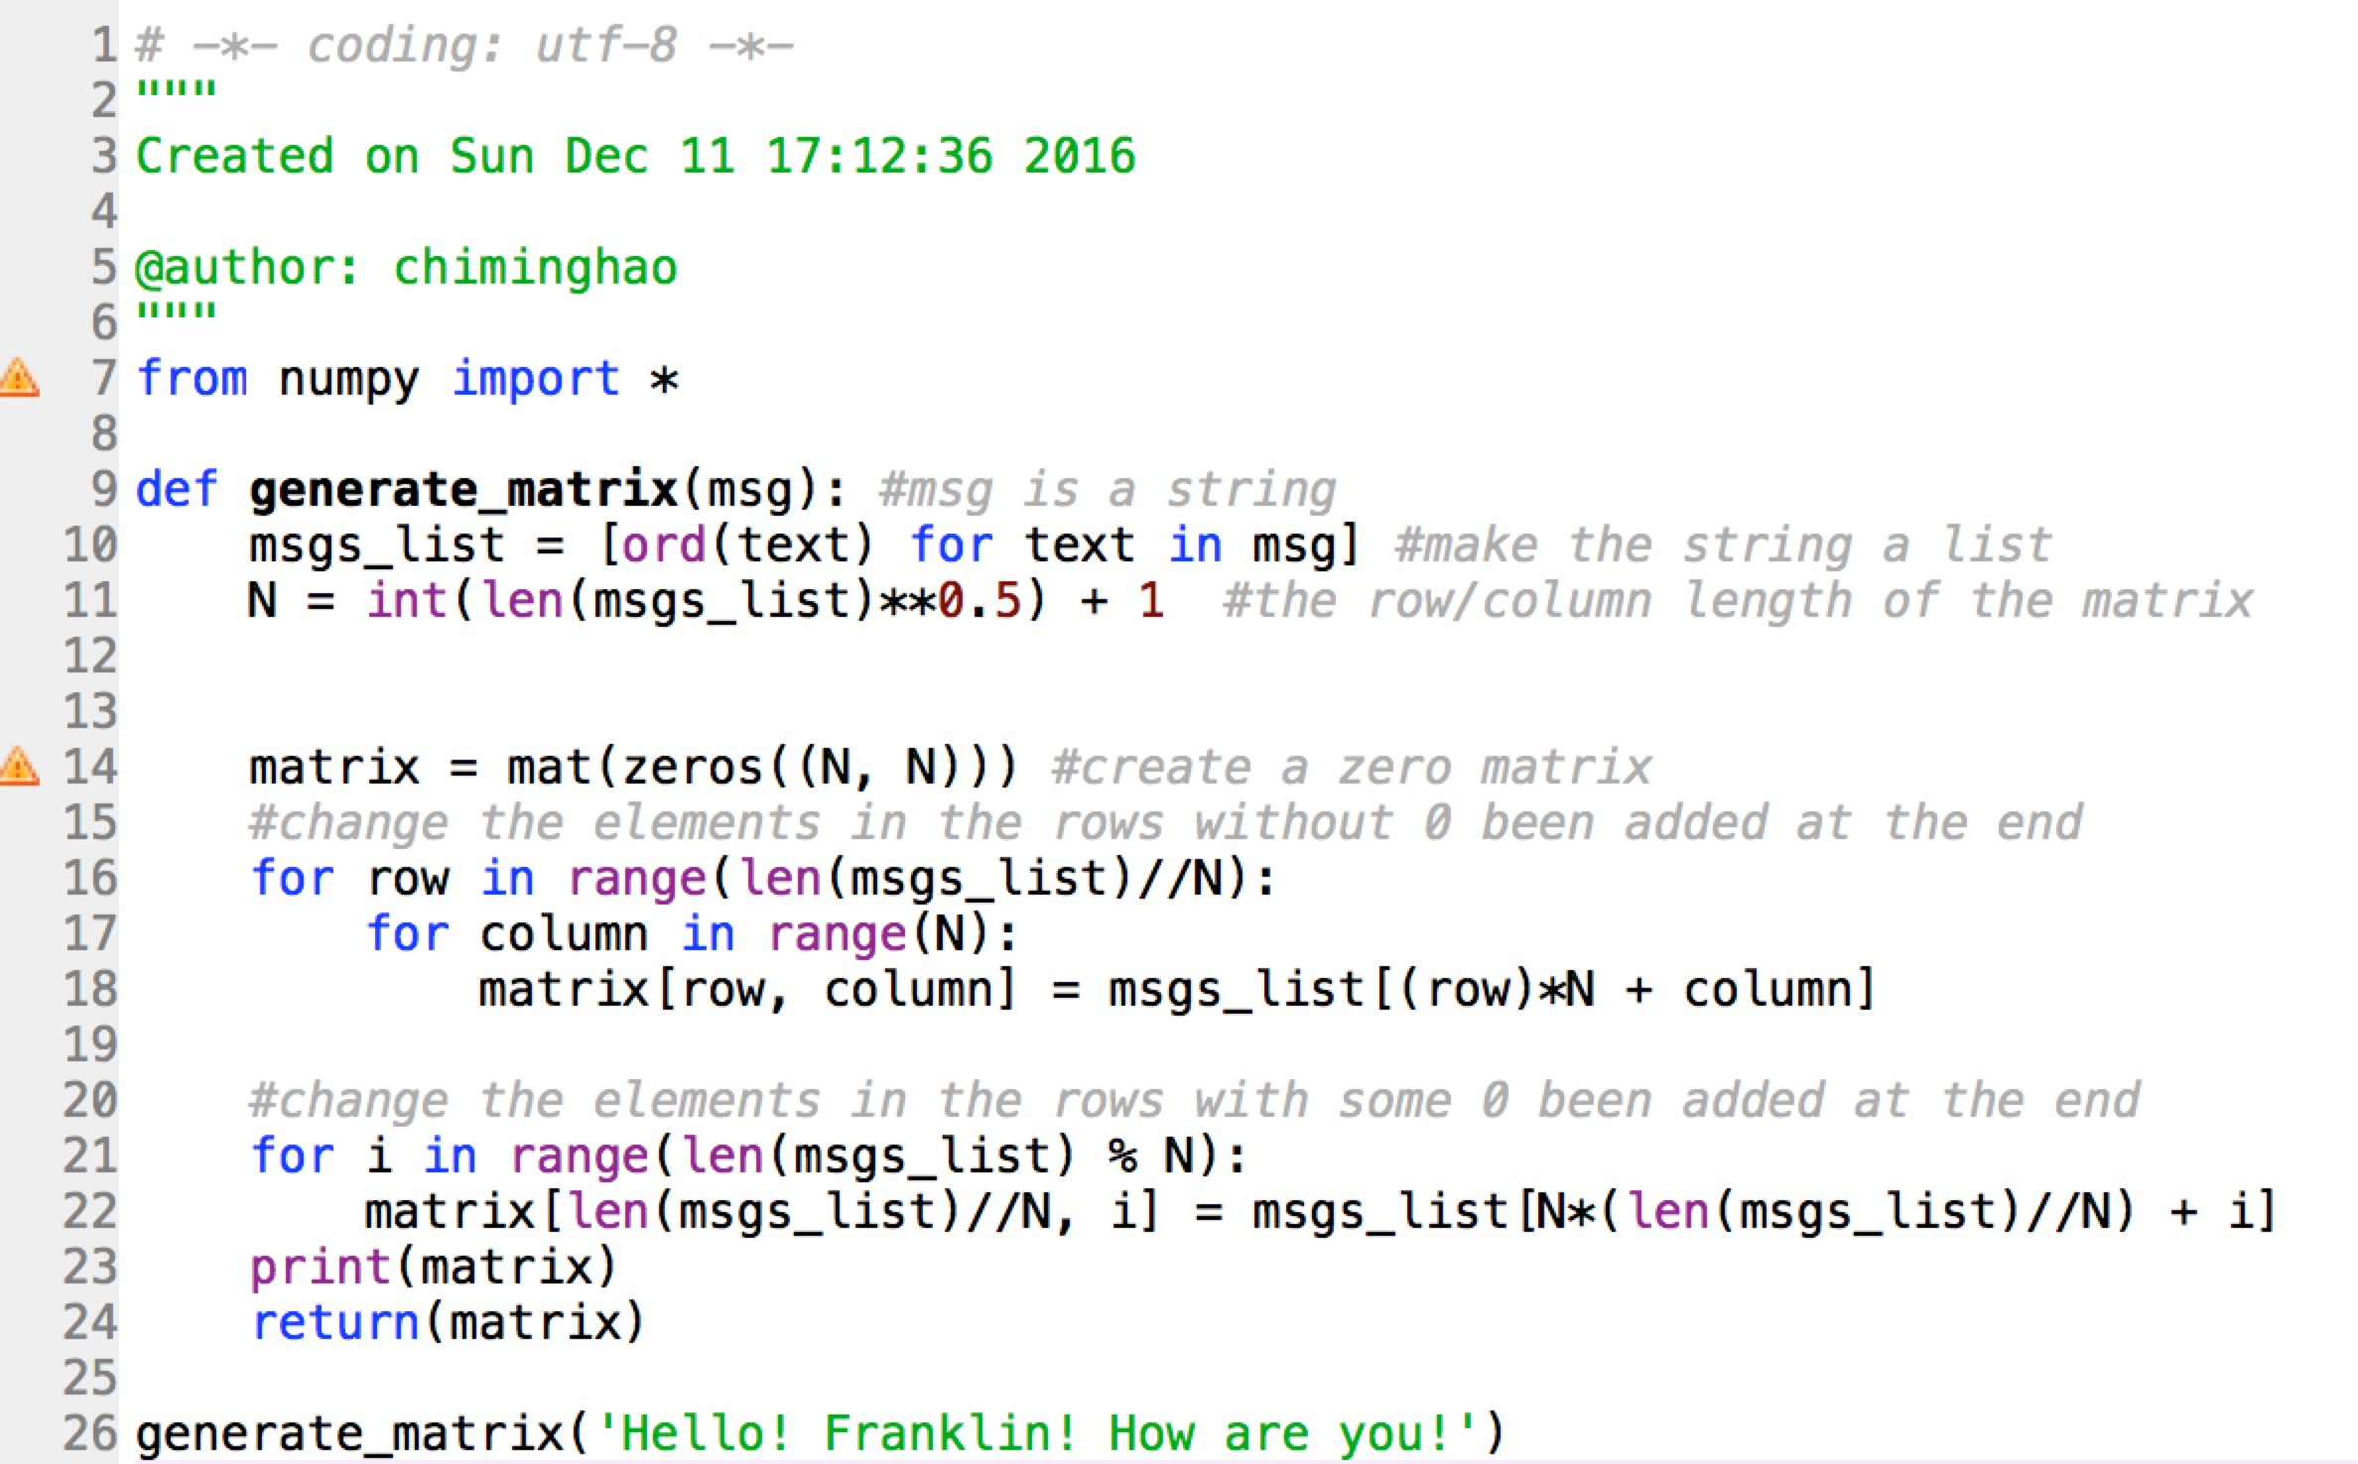
Another approach: N*N matrix
There is only one matrix, and the size of the matrix is determined by the length of the message
N = int(len(msgs_list)**0.5)+1

Slide 16
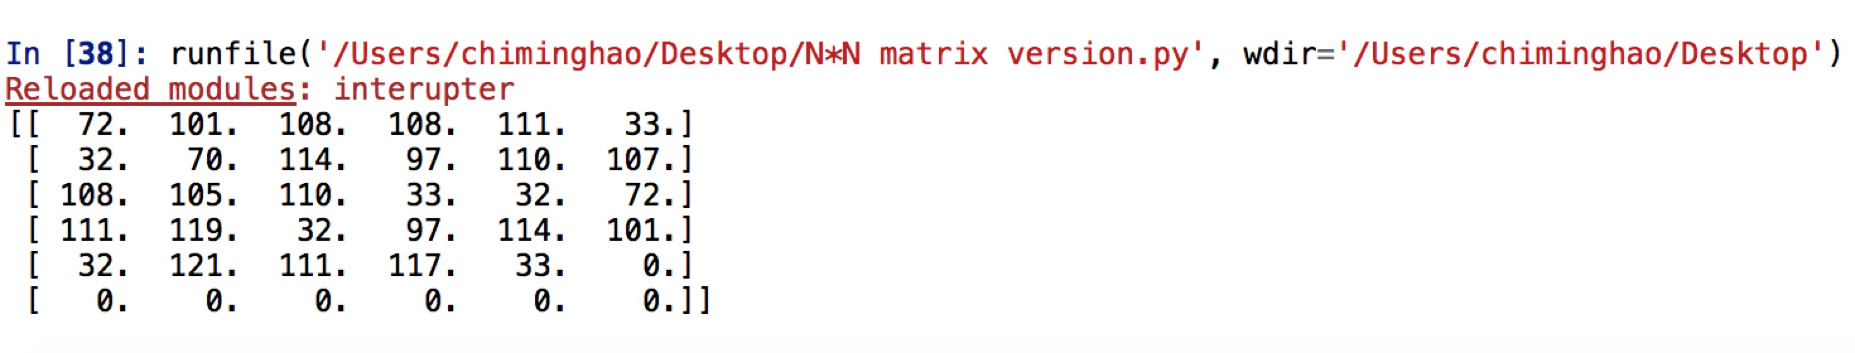
Another approach: N*N matrix
This gives a large matrix, and the size is determined by the length of msg
The other principals are the same as they are in 3*3 matrix

Slide 17
Comments on N*N matrix
Benefit: Less redundancy, and since there is only one matrix online, we don’t need to worry about some serious corruption such as missing one matrix
Weakness: Hard to detect and correct all the mistakes in the message since the matrix might be very big

Slide 18
Serialization of Python Objects
JSON
short for JavaScript Object Notation, a lightweight data interchange format, serializing basic Python object structure into a string, can also be used other languages
Pickle
a module implements binary protocols for serializing and de-serializing a Python object structure, only for Python

Slide 19
Distributed Indexing and Searching System

Slide 20
Architecture
Server
Client 1
Client 2
Client 3
Client 4
…

Slide 21
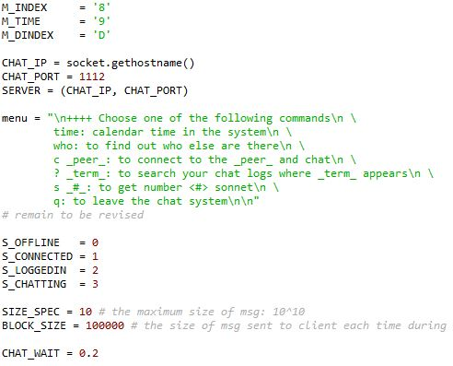
Global Setting
Constant
Declaring
chat_utils.py

Slide 22
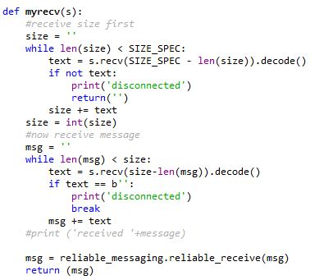
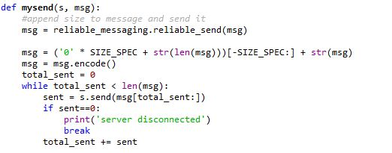
Combining Reliable Messaging into the Project

Slide 23
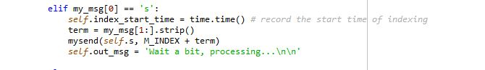
Client Side – Send Search Request
client_state_machine.py

Slide 24
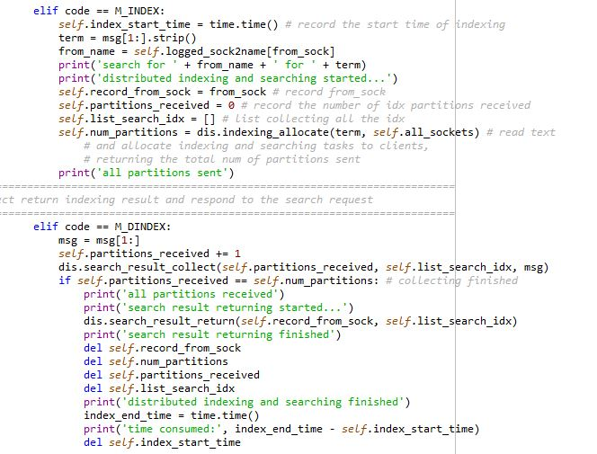
Server Side
Take Search Request
chat_server.py

Slide 25
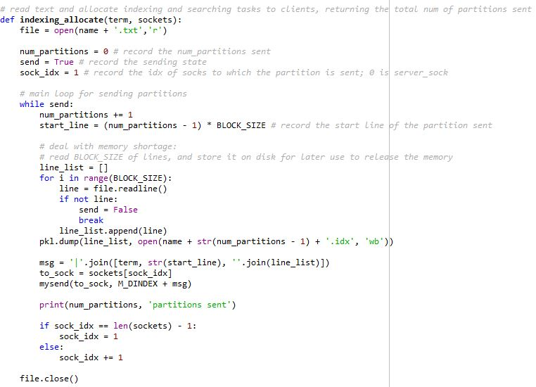
Server Side
Allocate Indexing Tasks
distributed_indexing_server.py

Slide 26
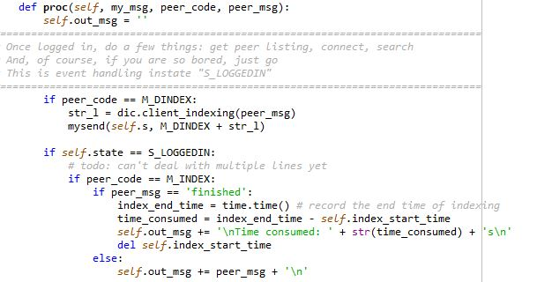
Client Side – Take Index Task

Slide 27
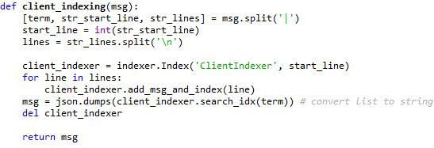
Client Side – Indexing and Searching
distributed_indexing_client.py

Slide 28
Server Side
Collect and Send Back Results
chat_server.py

Slide 29
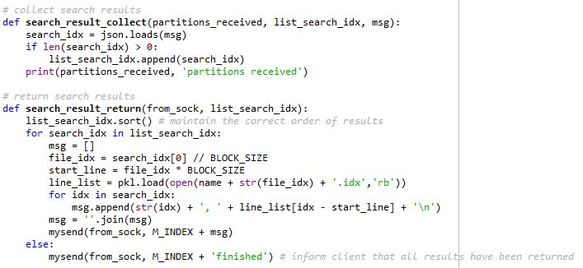
Server Side – Collect and Send Back Results
distributed_indexing_server.py

Slide 30
Client Side – Output Search Results
client_state_machine.py

Slide 31
Notes:
反常现象：CPU Core

Slide 32
Memory Control
Server with MemorySaving:
Only read part of the file to excecute at one time

Slide 33
Memory Control
Server with MemorySaving:
Find the corresponding idx file to extract lines again

Slide 34
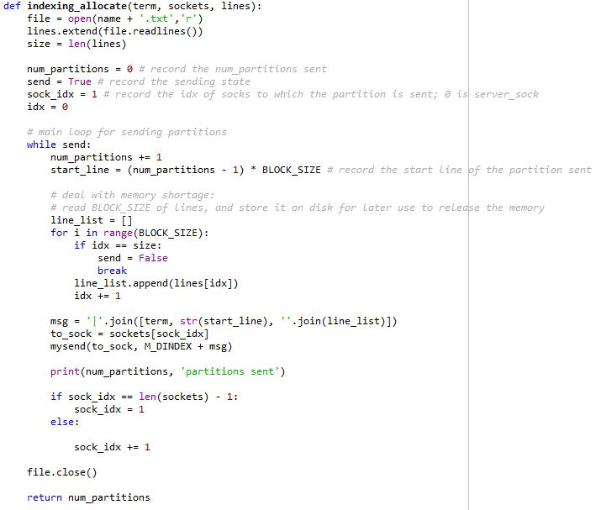
Memory Control
Read all lines into memory at once

Slide 36
Judge and Weigh – Loss of Efficiency?
* Time counted on the server side used

Slide 37
Judge and Weigh – Loss of Efficiency?

Slide 38
Thank you!

